Slide 1
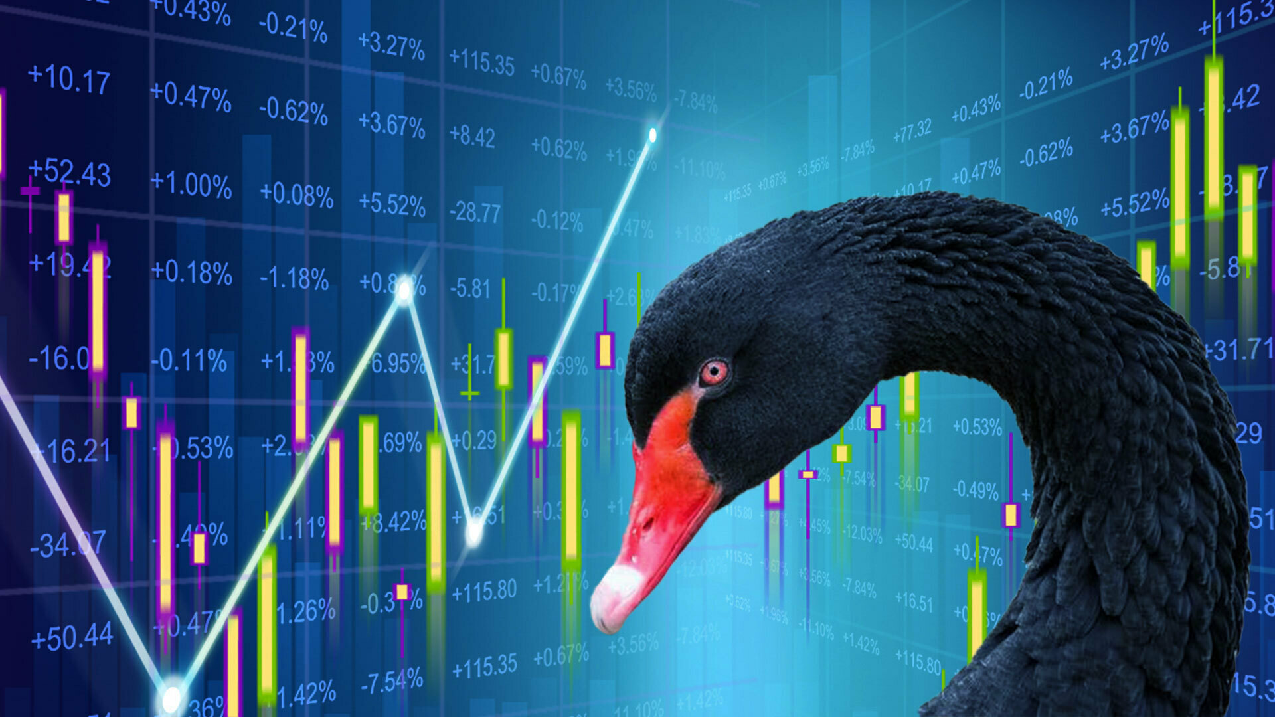

The Black Swan Token
By: Deron Porter, Carl Bent, Chin Hsu, Otha Richardson lll, and Cassandra Toroian

Slide 2
Executive Summary
The current day market is mostly driven by algorithmic trading bots, and the fear and greed of investors. Every investor wishes they could predict the market, and even som
The risk taken when investing is not only associated with the current economic status of their current country… but in fact the whole world.

Slide 3
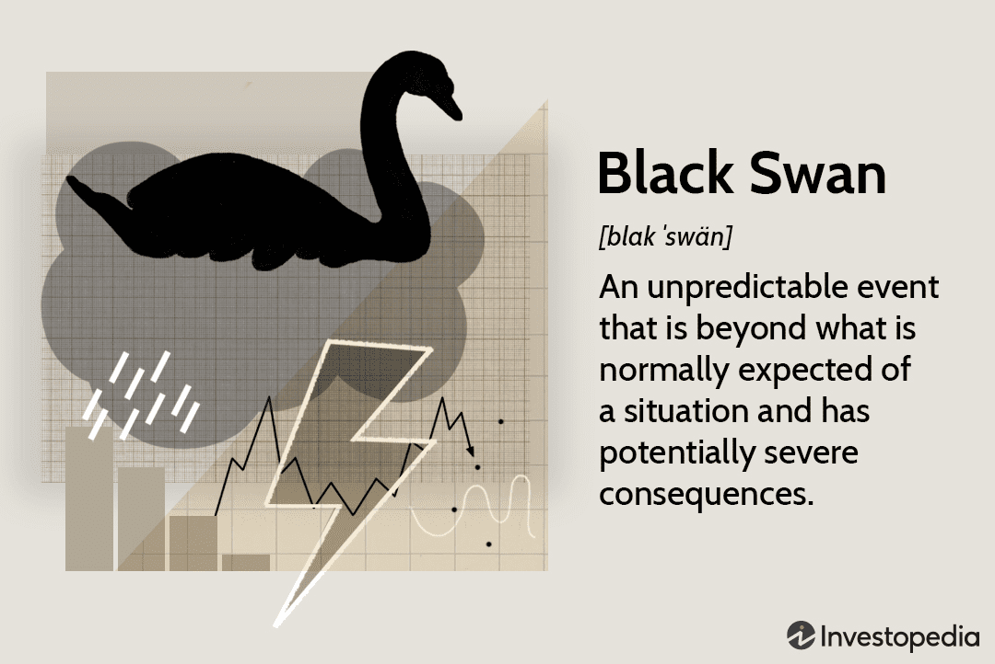
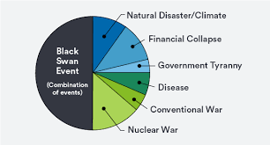


Slide 4
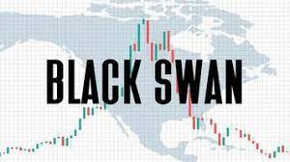
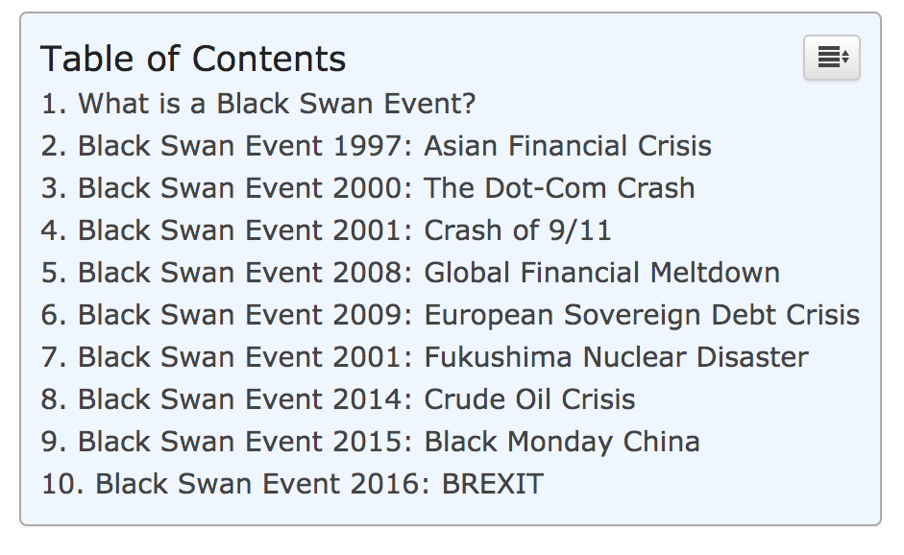
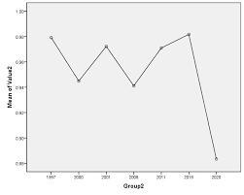

Slide 5
Concept
Description
When the market drops during a black swan event, our coin will increase in value.
Motivation for development?
People lost a lot of money from the current market drop during the pandemic.
There is currently no other option like our token on the market.
Great investment opportunity.
User story
“I am an investor that has PTSD from the 2007 Great Recession and from the market crash in 2020. I am looking for an investment that will keep me from losing money during the next black swan event.”

Slide 6
Data Techniques
Description of data source.
Gold, SPDY, DJIT, NASDAQ, FTSE, VIXX, SPX, Treasury Bond, SSE Shanghai SE composite index, Hang Seng
Reasoning for data selection.
All of the ETFs and Indexes represent a certain market or commodity within the whole financial market
Non Bias
Not only taking the U.S. Markets because Black Swan events affect the whole world.
Collection, exploration and cleaning process.

Slide 7
Approach
Technologies used
Languages & Libraries: Solidity (Open Zeppelin), Python (Pandas, NumPy)
Platforms: Remix, Jupyter Lab, Visual Studio Code
Amazon Web Services: S3, CloudFront, Route53, EC2, Certificate Manager, VPC
Breakdown of tasks and roles
Carl- Amazon Web Services (VPC, S3, EC2, Route 53, and CloudFront) and Powerpoint.
Deron & Chin- Solidity, Web3 and Blockchain.
Otha & Cassandra- Python, APIs, data aggregation and data visualisation.
Challenges
Finding the right ETFs and indexes to reflect a black swan event.
Working with Route 53 Records
Successes
Configuring a VPC without using the default VPC setting.
Being able to host a streamlit application on AWS

Slide 8

Demo

Slide 9
Next Steps
Additional questions that surfaced.
How to integrate our project with AWS CloudWatch Alarms
Why certain international Stocks were not working with our python API code.
Additional topics to research.
How to market our coin to investors and cryptocurrency exchange platforms.
What additional factors contribute to a black swan event?
Plan for future development.
Add a wider range of ETF’s, commodities, bonds, and more.
Bring our coin to all major cryptocurrency exchange platforms.

Slide 10
Our coin will prevent you from becoming this…

Slide 11
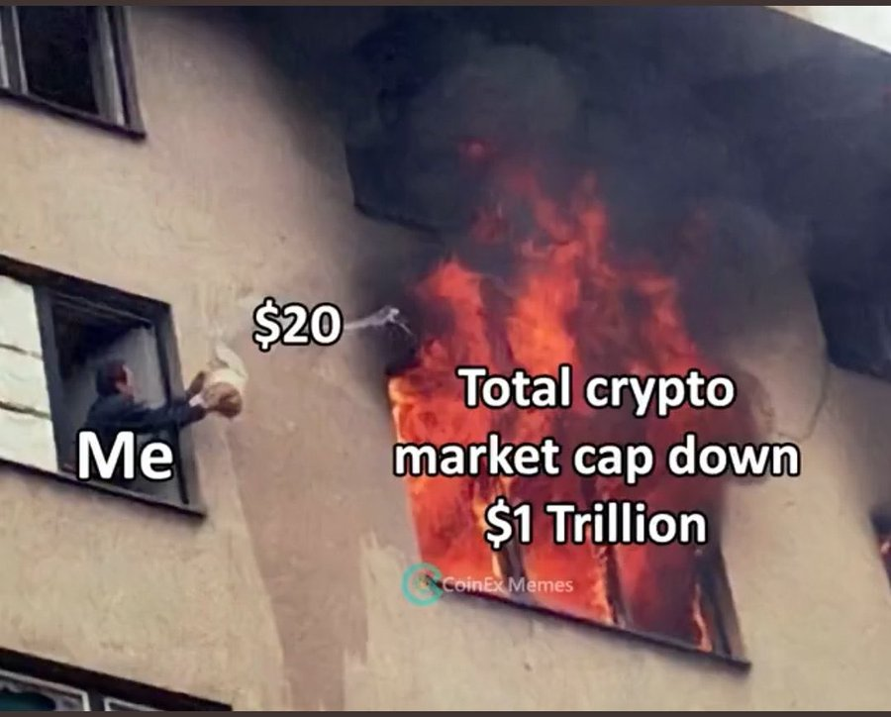
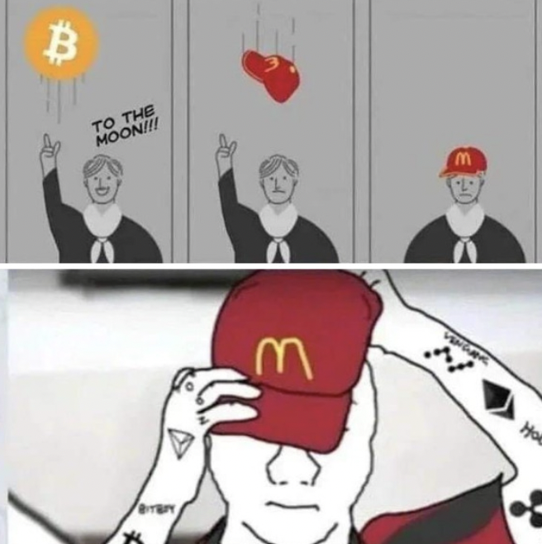
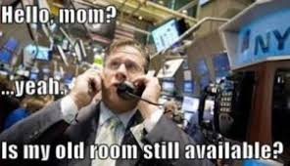
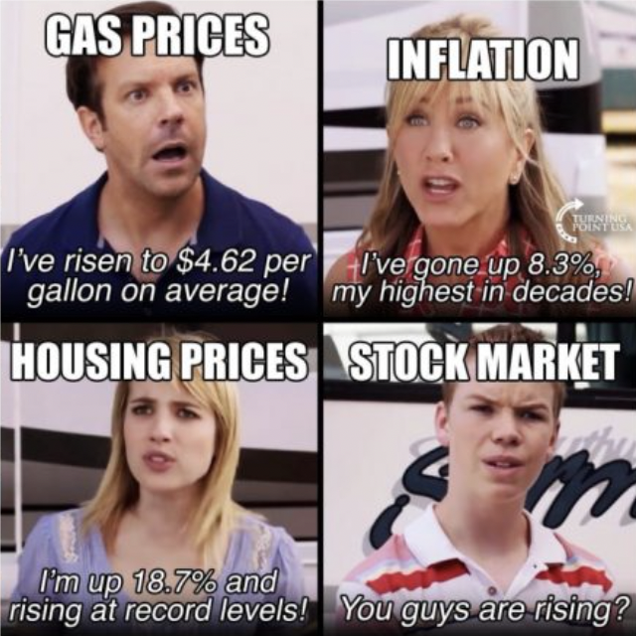
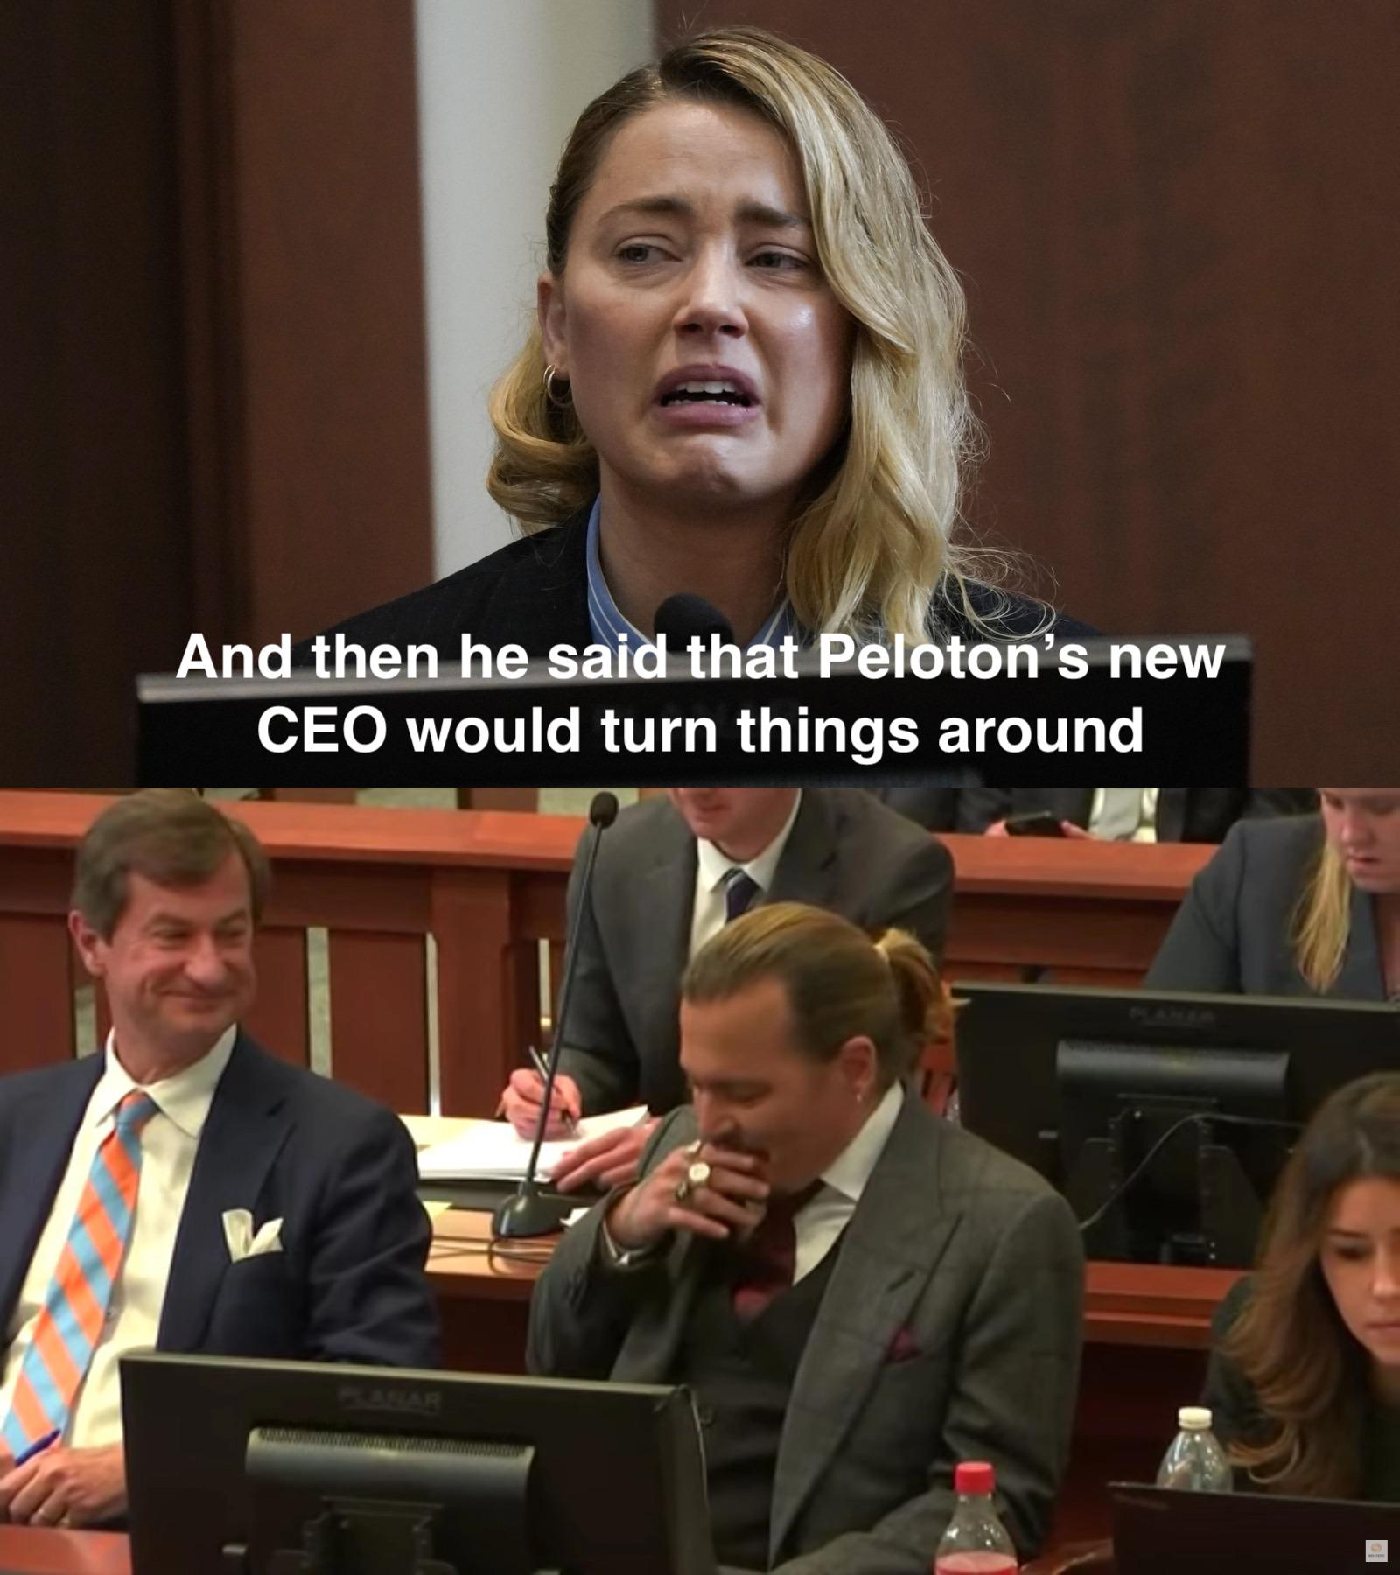
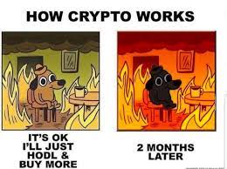

Slide 12
Links
Deployed application.
GitHub repo.
Our Token
Poll

